Slide 1
Napster and its legacy

Slide 2
1.Napster's Emergence and Popularity:
Context: Napster was the first widely recognized peer-to-peer (P2P) file-sharing system, primarily used for sharing digital music files.
Success: It became extremely popular after its launch in 1999, with millions of users sharing music files simultaneously.
Architecture: Napster used centralized indexes to manage file-sharing, but the actual files were stored on users' personal computers.

Slide 3
2. Key Features of Napster's Operation:
Centralized Indexing: Users uploaded links to their shared files to Napster's centralized indexing service.
Distributed Storage: Files were stored on users' computers, making the system scalable and decentralized.
Network Locality: Napster considered the proximity (number of network hops) between users when allocating resources, which helped in load distribution and scalability.

Slide 4
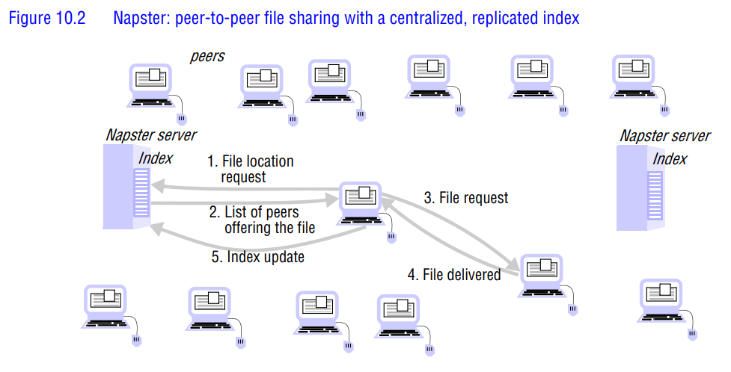

Slide 5
3. Legal Issues and Shutdown
Legal Challenges: Napster faced legal action from copyright owners of the music files shared on its platform.
Outcome: The service was eventually shut down due to copyright infringement issues.

Slide 6
4. Anonymity in Peer-to-Peer Systems:
Concerns: Anonymity for both providers and receivers of shared data is a key concern in P2P systems.
Techniques: Anonymity can be achieved through:
  Tortuous Routing: Making request routing complex to hide the source.
  File Distribution: Splitting files across multiple nodes to distribute responsibility.
  Encryption: Encrypting files to allow server owners to plausibly deny knowledge of contents.
Limitations: Anonymity techniques are not foolproof and can be vulnerable to certain attacks.

Slide 7
5. Projects Focused on Anonymity:
Freenet and FreeHaven: These projects aim to provide anonymous file-sharing services on the Internet.
Eternity Service: Proposed by Ross Anderson, this service focuses on long-term data availability and resistance to censorship, emphasizing the importance of anonymity for data persistence.

Slide 8
6. Lessons Learned from Napster:
Feasibility of Large-Scale P2P Services: Napster demonstrated that a large-scale service could be built using resources owned by ordinary Internet users.
Load Distribution: Napster's use of network locality helped in scaling the service to accommodate a large number of users without overloading individual nodes.
Limitations:
  Centralized Indexing: Napster's reliance on a unified index could become a bottleneck for other applications requiring consistent data access.
  Application-Specific Design: Napster was optimized for music file sharing, which has unique characteristics (e.g., files are never updated, no strict availability guarantees).

Slide 9
7.Application-Specific Advantages:
No File Updates: Music files are static, eliminating the need for consistency across replicas.
No Strict Availability Requirements: Temporary unavailability of files is acceptable, reducing the need for high dependability of individual nodes.

Slide 10
Key Takeaways:
Napster's Legacy: Napster pioneered the concept of large-scale P2P file-sharing, demonstrating both the potential and challenges of decentralized systems.
Scalability and Load Management: Techniques like network locality can help in scaling P2P systems.
Anonymity Challenges: While anonymity is crucial in P2P systems, achieving it is complex and often comes with trade-offs.
Application-Specific Design: The success of P2P systems often depends on tailoring the architecture to the specific needs of the application (e.g., static files in Napster's case).

